Slide 1
Restaurant Rating Prediction
BARAH (C0860531)
CATHARIN JOSE (C0860087)
DANNY JOSE (C0864600)
SRI BINDU CHINTAKAYALA (C0857498)
AIMT DEPARTMENT, LAMBTON COLLEGE
2022F AML 2103 1 VISUALIZATION FOR AI AND ML
PROFESSOR VAHID HADAVI
DECEMBER 17, 2022

Slide 2
TABLE OF CONTENTS
Introduction
Data Preprocessing
​Exploratory Data Analysis
Visualization
Data Modeling
​Result and Conclusion

Slide 3
Introduction
Predictive modelling is a type of data mining that examines past data in order to spot trends or patterns, then applies those revelations to forecast what will happen in the future
To perform machine learning tasks and predict the rating of a specific restaurant, we are creating a "Restaurant Rating Prediction System.“
The main goal of analyzing the restaurant dataset is to gain a thorough understanding of the variables influencing the establishment of various types of restaurants throughout India.
Due to the enormous demand for restaurants, it is now crucial to understand a location's demographics. What kind of food is more common in a given area. The community as a whole enjoys vegetarian food.

Slide 4
Data preparation
The restaurant dataset, which was collected from an online food ordering website, has 51717 rows and 17 columns.
The restaurant dataset includes information on nearly 12,000 restaurants.
Our dataset includes data on the URL, address, name, online order, table booking, rating, and votes as well as the location and type of restaurant.
Libraries used in our dataset are NumPy, Pandas, matplotlib, seaborn and sklearn

Slide 5
Data cleaning
In our restaurant dataset, the columns for rate, phone, location, rest type, liked dishes, cuisines, and approximate cost all have null values.
Remove a few of the unnecessary columns from the analysis, including url, address, and phone.
The cost two columns’ and rate column’s null values treated with mean.
In our dataset, we used One Hot Encoding to convert all object types to numbers.

Slide 6
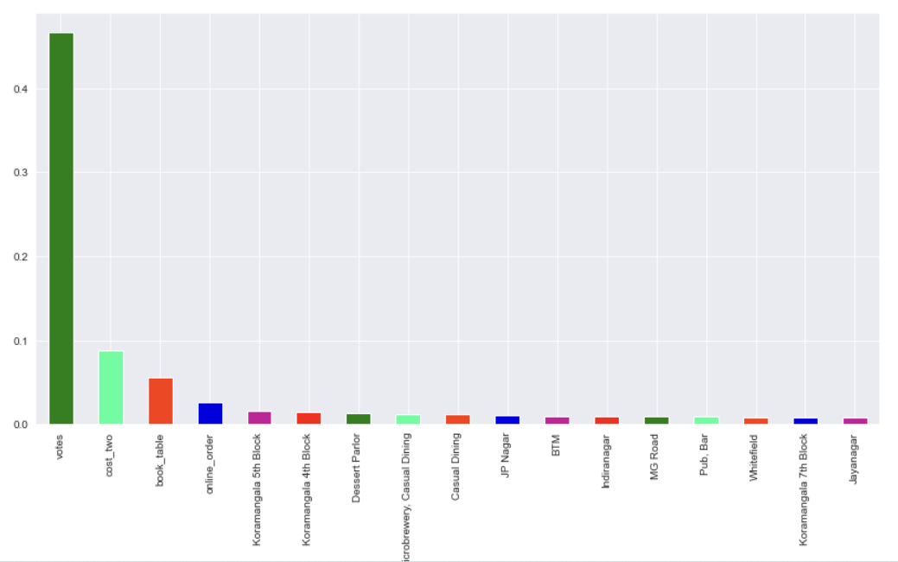
Exploratory Data Analysis
Feature Importance
A higher score indicates that the particular feature will have more of an impact on the model being used to forecast a particular variable.
The most important columns in our dataset are votes, cost two, book tables, and online order.

Slide 7
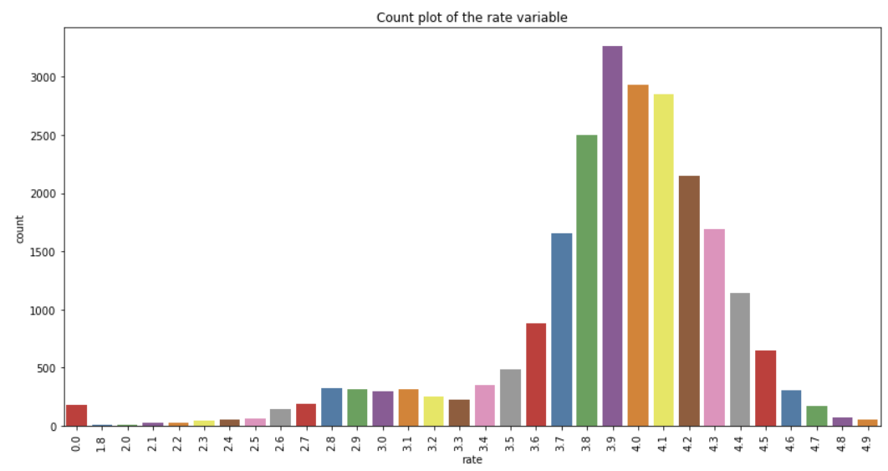
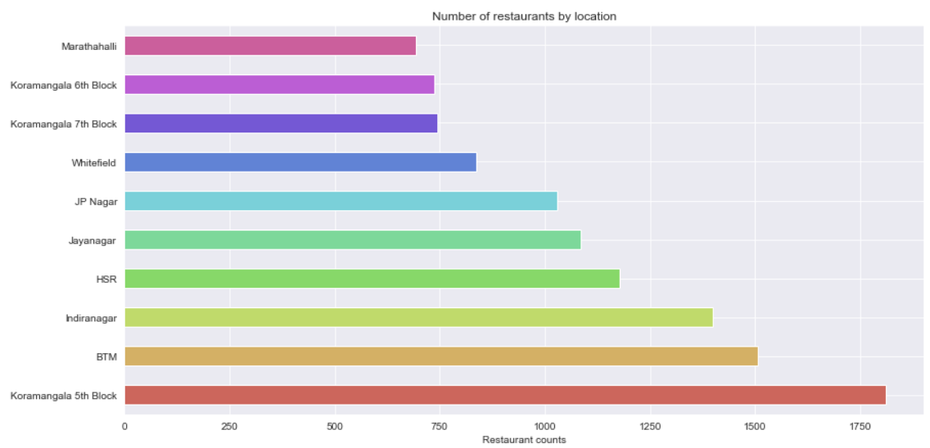
Data visualization
According to the graph, the majority of restaurant ratings fall between the range of 3.4 and 4.2. There are not many restaurants with a 4.8 and 4.9 rating.

Slide 8
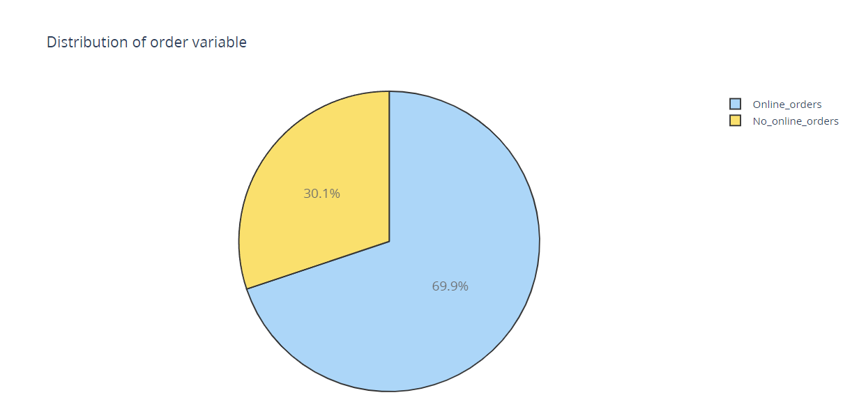
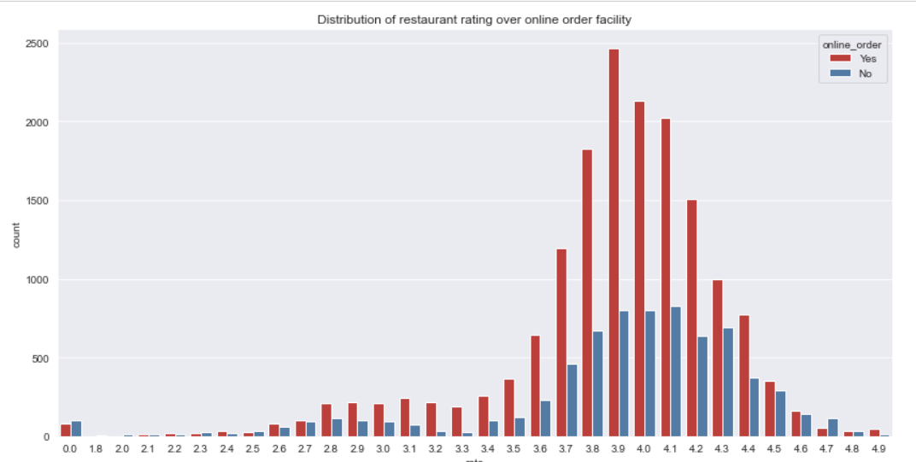
Data visualization
According to the above- mentioned pie chart, people prefer ordering food online to dining in a restaurant.
If a restaurant does not offer online ordering, we can clearly see that they are more likely to suffer a rating fall than those that do.

Slide 9
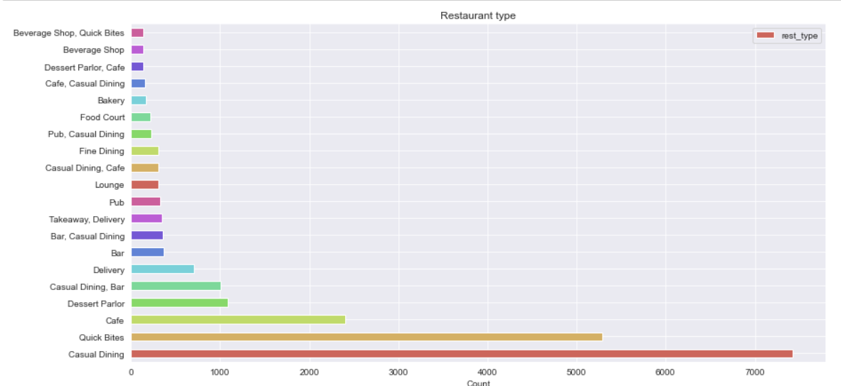
Data visualization
The top 20 restaurant types are shown in the images above. As compared to the other restaurant types, it is clear that Casual Dining and Quick Bites is more well-liked by customers.

Slide 10
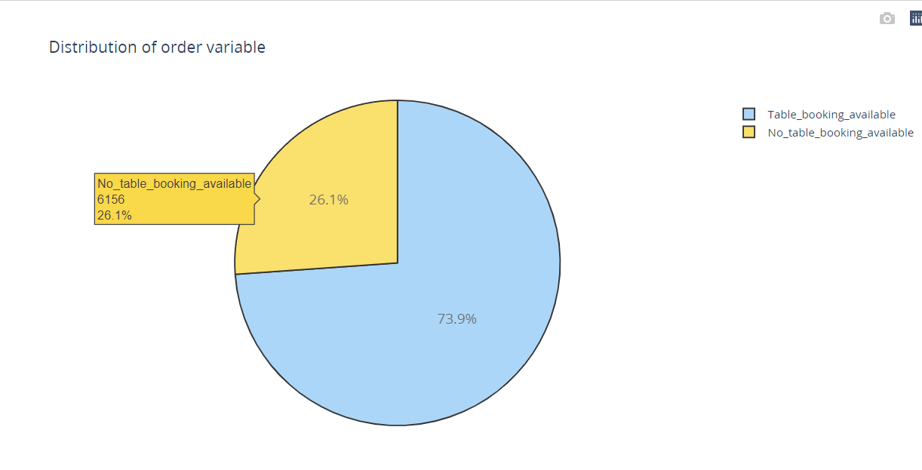
Data visualization
We can see from the pie chart above that 73.9% of the restaurants offer the option to reserve a table, while 26.1% do not have table booking availability.

Slide 11
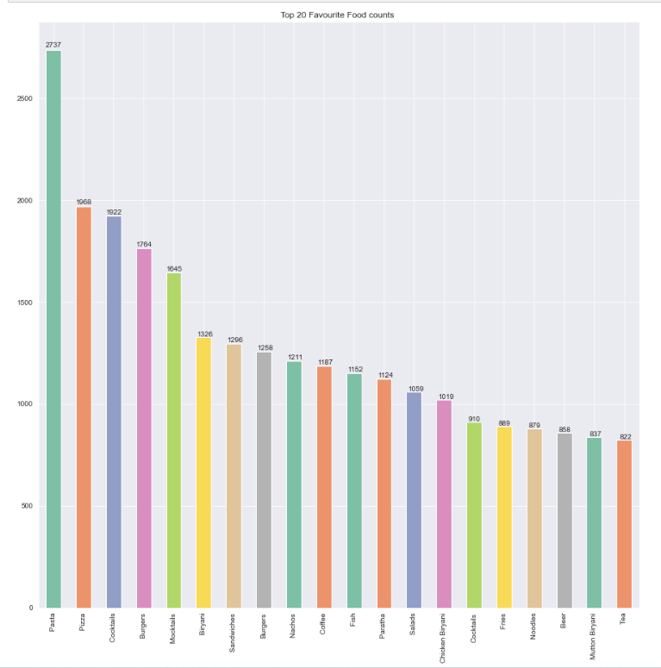
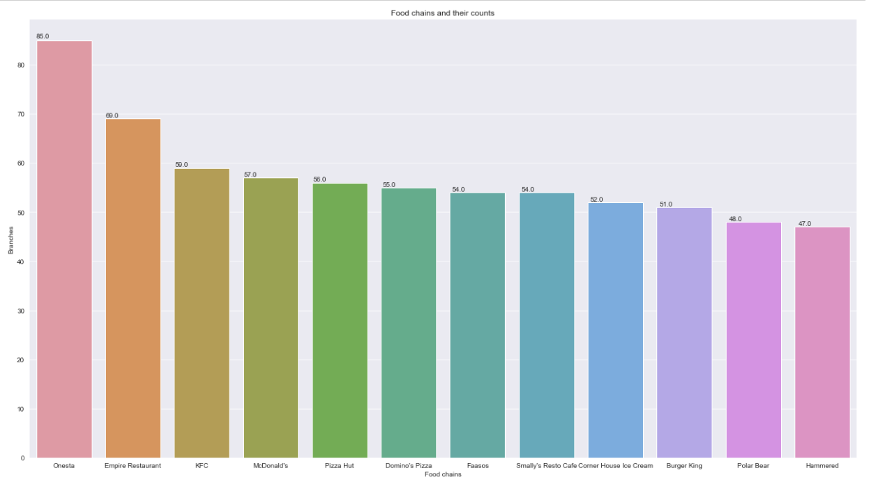
Data visualization
The above graph showing top foods in restaurant and below graph showing the top food chains .

Slide 12
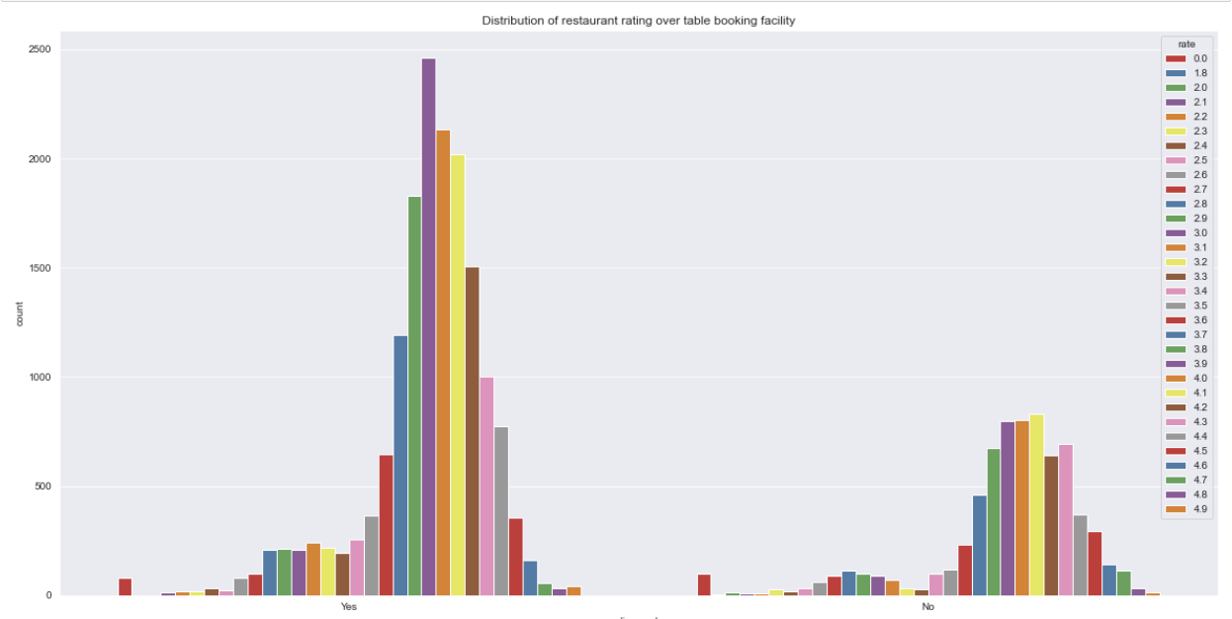
Data visualization
The ratings have a significant impact the restaurant reservations. The restaurants which are having table booking facility tends to have higher ratings as compared to the restaurants which do not have table booking facility available with them.

Slide 13
Data modeling
For creating the model, we used the Random Forest algorithm, a supervised learning algorithm.
Our target variable is the ‘Rate’ column which is the rating of all food items from different restaurants.
The training and testing datasets are split on an 80/20 ratio with random state 42.
For evaluating metrics, we have used the R2 score, MAE and accuracy score
The R2 score of the testing model is 81.42 and MAE is 3.88 degrees and the accuracy is 98. 35 %.

Slide 14
Conclusion
Restaurant ratings vary from 3.4 to 4.2, with a few restaurants receiving a rating of 4.8.
Onesta is the highest number of food chains with 85, followed by Empire Restaurant with 69 and KFC with 59.
The most popular dish is pasta with 2695 votes, followed by pizza with 1916 and cocktails with 1882.
We have used the Random Forest algorithm for training and testing the model, and the R2 score of the testing model is 81.42 and MAE is 3.88 degrees and the accuracy is 98. 35 %.

Slide 15
THANK YOU

